Slide 1
How Data Structures Power Your Favourite App
By Team Full Stop

Slide 2





MEET OUR CONTRIBUTORS
Shahriar Hossain Nibir
ID: 232-15-706
Mohammed Tawhidul Haque
ID: 232-15-307
B.M Zayed Mahin
ID: 241-15-279
Akram Hossain
ID: 241-15-750
Adnan Islam
ID: 241-15-471

Slide 3
A Quick Overview
Imagine opening your favorite social media app. As you scroll through your feed, heaps and priority queues work behind the scenes to show you the most relevant content. Switch to an e-commerce app, where hash tables and tries make product searches fast and recommendations spot-on.
In navigation apps, graph algorithms like Dijkstra’s help you find the shortest routes, making travel efficient.
Music streaming apps use linked lists and hash maps to manage playlists, ensuring a smooth listening experience. Even fitness apps utilize arrays and linked lists to track your activities.
Data structures power every tap, search, and swipe, making your app interactions smooth and enjoyable. They are the backbone of modern apps, enhancing your experience in countless ways.

Slide 4
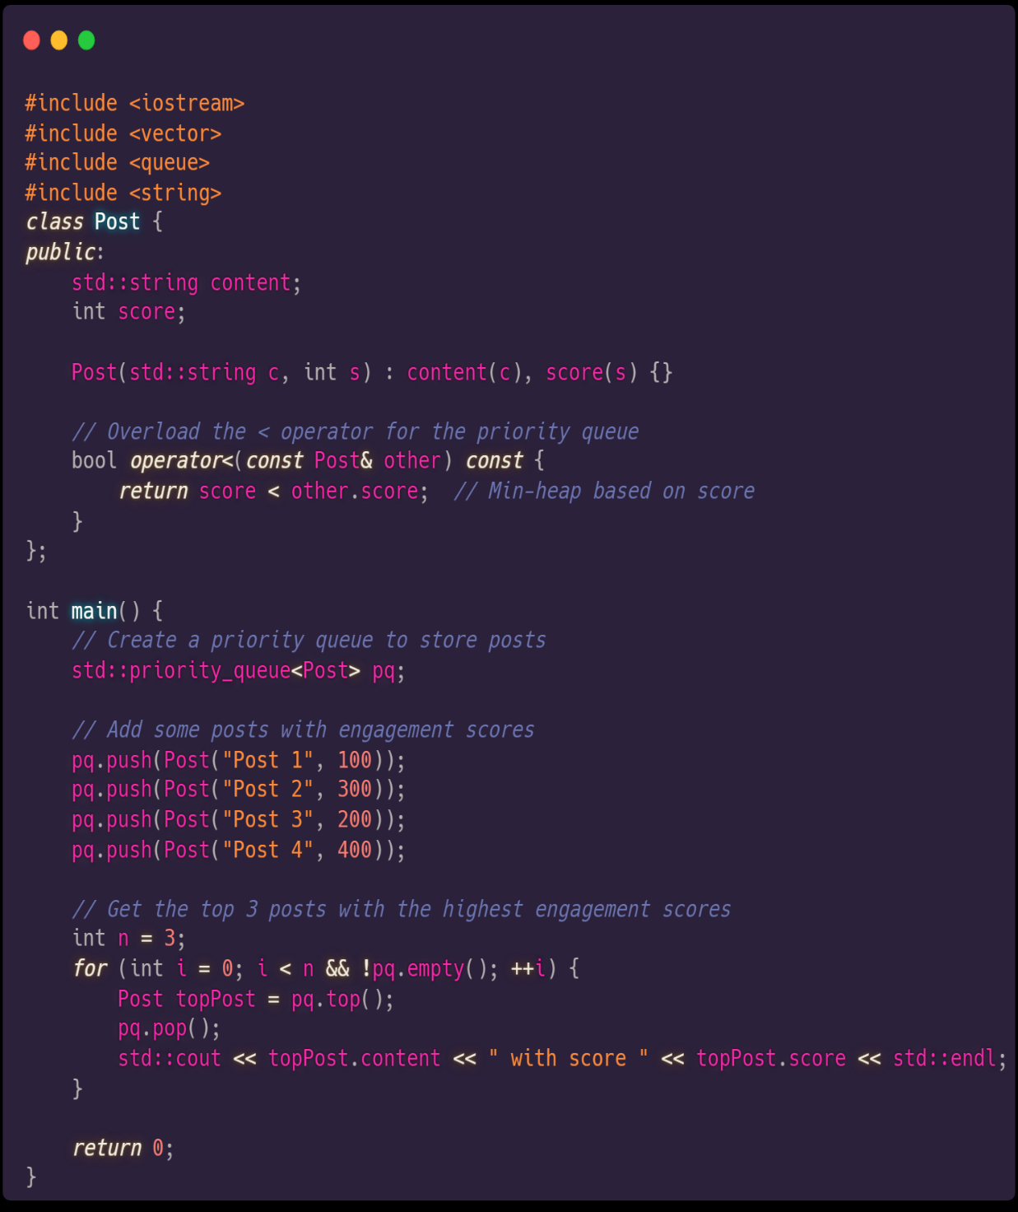




Data Structures Powering your Social Media App
In a social media app, data structures work their magic behind the scenes, keeping everything running smoothly. Think of a priority queue as your personal curator, showing you the most engaging posts first. This clever use of data structures ensures you get a engaging experience every time you scroll.
Here`s a simple feed implementation where we’re using object-oriented approach(Class) of heap(priority queue). Based on engagement score feed displays most engaging post.

Slide 5

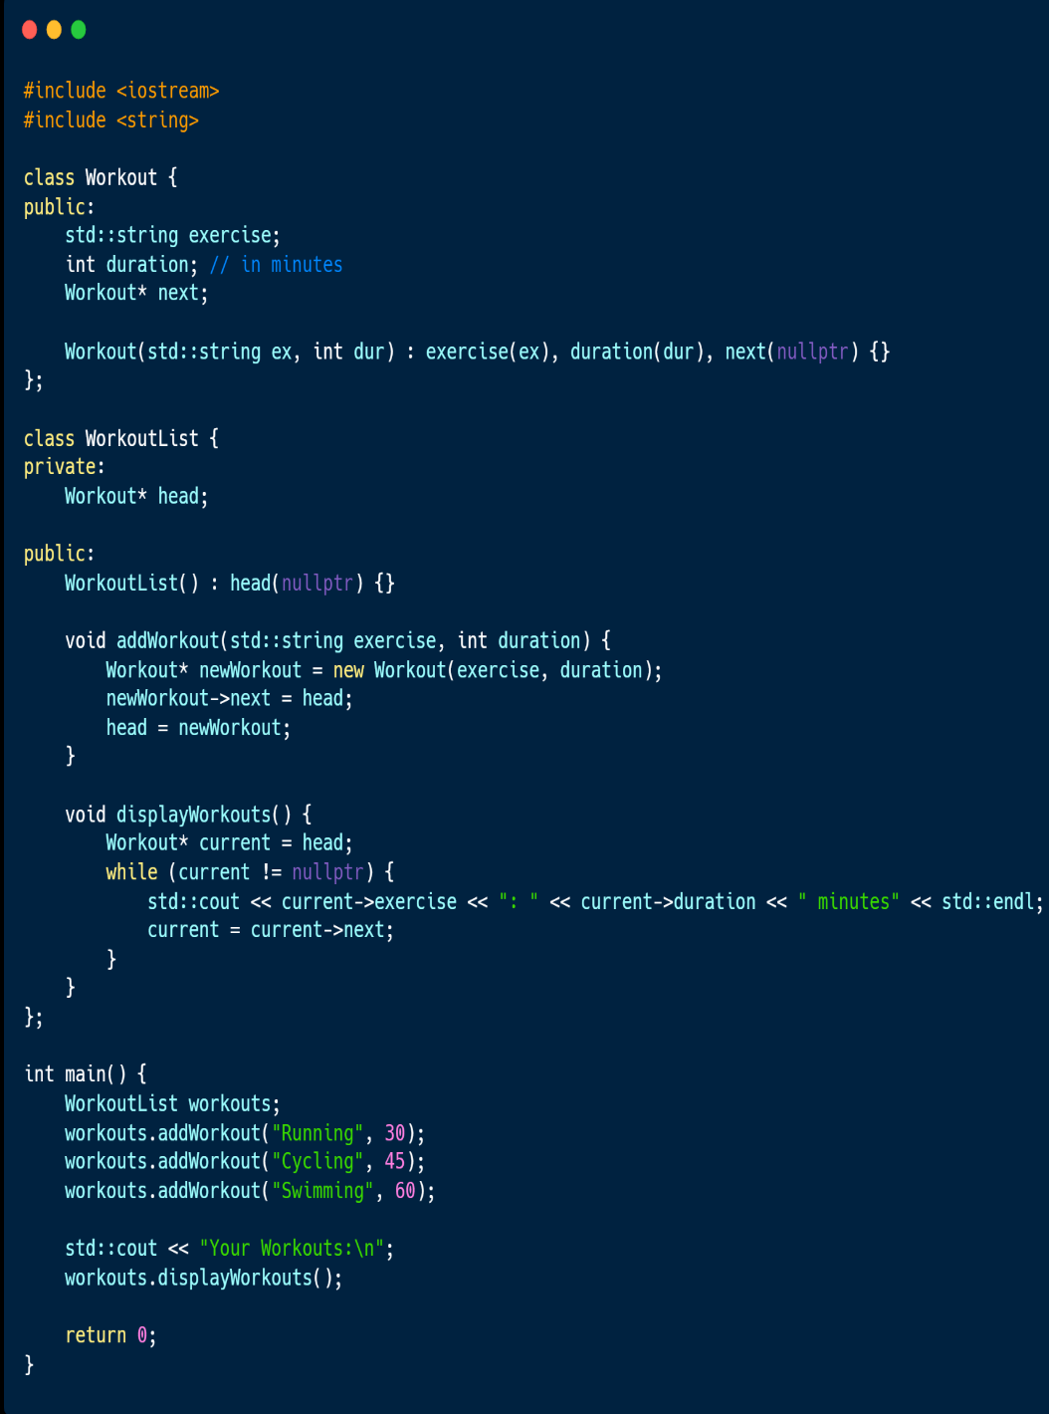


Data Structures Powering your Fitness App
In a fitness app, data structures plays a vital role that efficiently track and manage your workout data. Imagine logging your daily exercises and instantly seeing your progress—this happens seamlessly behind the scenes. For example, linked lists can be used to manage your workout sessions, allowing you to add, remove, and track exercises effortlessly. This makes your fitness journey smooth and enjoyable, ensuring that you stay motivated and on track to achieve your goals.

Slide 6



Data Structures Powering your Music App
In a music app, data structures are the unseen maestros orchestrating a seamless and personalized listening experience. Imagine browsing through your playlists, discovering new songs, and enjoying uninterrupted streaming—all made possible by efficient data management behind the scenes. Hash tables can be used to store and retrieve song information quickly, ensuring you can instantly find and play your favorite tracks. By using hash tables, the music app ensures fast and efficient access to your favorite songs, enhancing your overall listening experience. This blend of data structures and programming keeps your music flowing seamlessly, just like your favorite playlist.

Slide 7




Data Structures Powering your E-Commerce App
In an e-commerce app, data structures work their magic behind the scenes to provide a seamless and personalized shopping experience. From rapid product searches to effective inventory management, data structures like hash tables and tries are vital to keeping everything running smoothly.
By using hash tables, the app can swiftly look up product details, manage a vast inventory, and provide real-time information to users. This allows customers to quickly find and purchase products, enhancing their overall shopping experience. Efficient use of data structures ensures the app runs as smoothly as your favorite online store.

Slide 8

Data Structures in Cloud Storage App: File Organization
In a cloud storage app, efficient file organization is essential for easy storage, retrieval, and management of files. Imagine it as a virtual filing cabinet that keeps all your documents, photos, and videos neatly organized and instantly accessible.
A tree data structure represents the hierarchical organization of files and folders, making navigation and management straightforward.

Slide 9

Data Structures in Messaging App: Fast and Secure Messaging
In a messaging app, ensuring fast, reliable, and secure communication is essential. Queues and encryption algorithms work together to provide this seamless experience, allowing users to send and receive messages quickly and safely.
Importance of Fast Messaging: Fast messaging ensures that conversations flow smoothly and users stay engaged. Immediate message delivery is crucial for effective communication.
Queue Implementation: Queues are used to manage the flow of messages. They handle the order in which messages are sent and received, ensuring that messages are delivered in the correct sequence.
Security Considerations: Security is paramount in messaging apps. Encryption algorithms protect messages by encoding them, ensuring that only the intended recipient can read them.
User Benefits: By using queues and encryption, messaging apps provide fast, reliable, and secure communication. Users can enjoy real-time conversations with peace of mind knowing their messages are protected.

Slide 10
Summary
Data structures are the hidden champions powering your favorite apps, ensuring everything runs efficiently behind the scenes. From organizing files in cloud storage to managing workouts in fitness apps and securing messages in chat apps, data structures like arrays, linked lists, trees, and hash tables play a crucial role. They enable swift data management, quick access, and dependable performance, transforming complex tasks into seamless user interactions. Next time you enjoy the smooth operation of an app, remember the vital role data structures play in making it all happen effortlessly!

Slide 11

We`re looking for questions and feel free to share any feedbacks.
Thanks For joining us.

